Slide 1
Modeling Recruitment in Stock Synthesis
Ian Taylor
CAPAM Recruitment Workshop, Miami
October 30, 2017

Slide 2
Outline
Big picture
Stock Recruit Relationships
Beverton-Holt, Shepherd, Maunder-Taylor-Methot
Recruitment deviations
Overview
SigmaR
Bias adjustment
Eras (Init/Early, Main, Late/Forecast)
Apportionment of recruitment
Time-varying stock-recruit relationships (regimes)
Recruitment autocorrelation
Recruitment in MCMC vs. MLE estimates
Simulating with random recruitment
A few ideas for the future
Some files on GitHub https://github.com/taylori/SSrecruitment

Slide 3
Big Picture
Stock synthesis (SS) has lots of options, especially related to recruitment
Most SS models have recruitment deviates around a parametric stock-recruit relationship
Age-structured surplus production models can be achieved by fixing deviations to zero
Recruits can by partitioned by area, season, etc., but there is always a single spawning stock (no metapopulation dynamics)

Slide 4
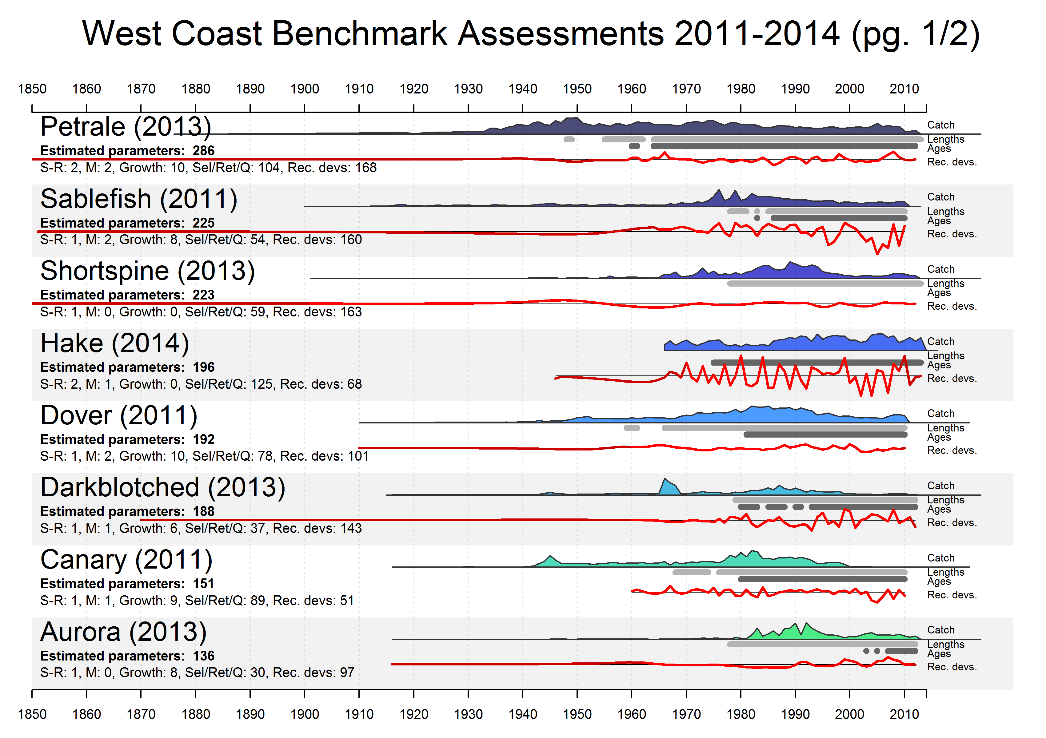
Summary of estimated parameters
Catch (scaled)
Years with length or age data
Recruitment deviations
Modeling recruitment over the full history of commercial fishing

Slide 6
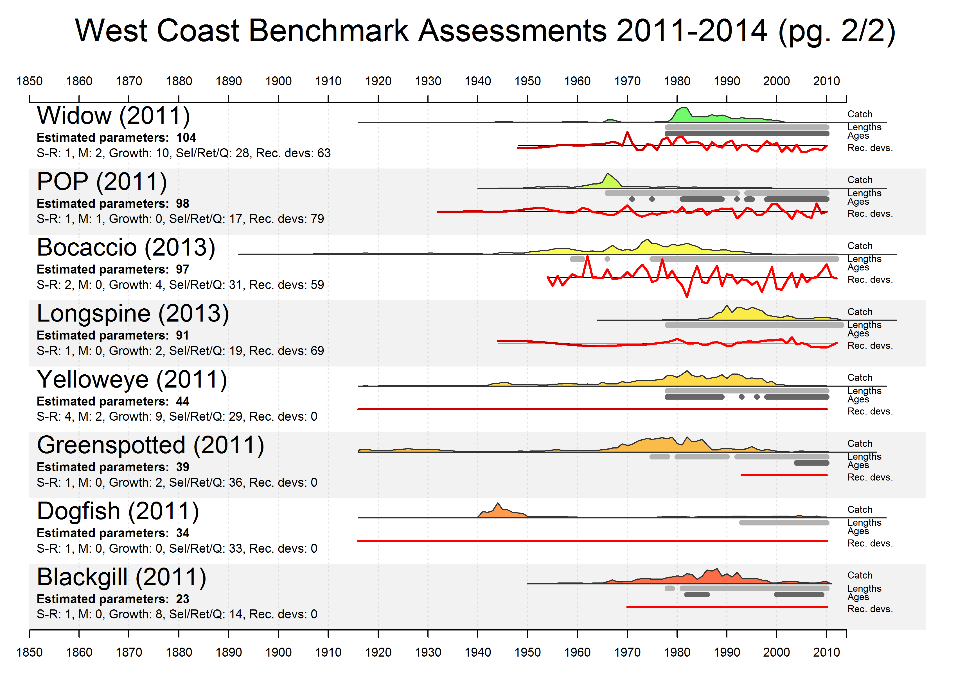

Slide 7
Motivation for use of stock-recruit relationships
Provides underlying structure allowing recruitment estimation outside range of composition data
Many alternative approaches are available
Stock Synthesis includes enough options to allow comparison among approaches

Slide 8
Stock Recruit Relationships

Slide 9
Control file setup for stock-recruit function
#_Spawner-Recruitment
3 #_SR_function: 2=Ricker; 3=std_B-H; 4=SCAA; 5=Hockey;
# 6=B-H_flattop; 7=survival_3Parm; 8=Shepard_3Parm
0 # 0/1 to use steepness in initial equ recruitment calculation
0 # future feature: 0/1 to make realized sigmaR a function of SR curvature
#_LO HI INIT PRIOR PR_SD PR_type PHASE ... # parm_name
5 20 10.6 10 5 0 1 ... # SR_LN(R0)
0.2 1 0.6 0.718 0.158 0 3 ... # SR_BH_steep
0.5 1.2 0.5 0.67 99 0 -6 ... # SR_sigmaR
-5 5 0 0 99 0 -50 ... # SR_regime
0 2 0 1 99 0 -50 ... # SR_autocorr

Slide 10
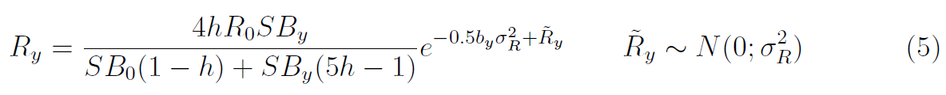
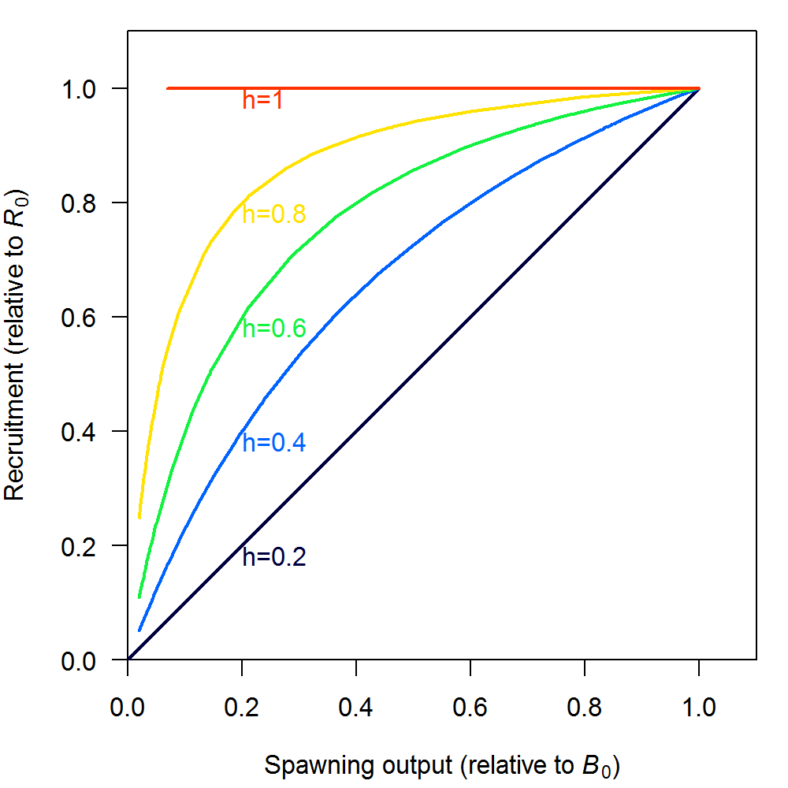
Beverton-Holt
Equations from SS User Manual (3.30.08)
Beverton-Holt is most common choice by far
R₀ is key scale parameter for most models,
h difficult to estimate, often doesn’t have strong impact on fit to data, but plays big role in reference points and forecasts

Slide 11
Control file setup for stock-recruit function
#_Spawner-Recruitment
8 #_SR_function: 2=Ricker; 3=std_B-H; 4=SCAA; 5=Hockey;
# 6=B-H_flattop; 7=survival_3Parm; 8=Shepard_3Parm
0 # 0/1 to use steepness in initial equ recruitment calculation
0 # future feature: 0/1 to make realized sigmaR a function of SR curvature
#_LO HI INIT PRIOR PR_SD PR_type PHASE ... # parm_name
5 20 10.6 10 5 0 1 ... # SR_LN(R0)
0.2 1 0.6 0.718 0.158 0 3 ... # SR_steepness
0.2 5 1.0 1.0 99 0 -4 ... # SR_Shepard_c
0.5 1.2 0.5 0.67 99 0 -6 ... # SR_sigmaR
-5 5 0 0 99 0 -50 ... # SR_regime
0 2 0 1 99 0 -50 ... # SR_autocorr

Slide 12
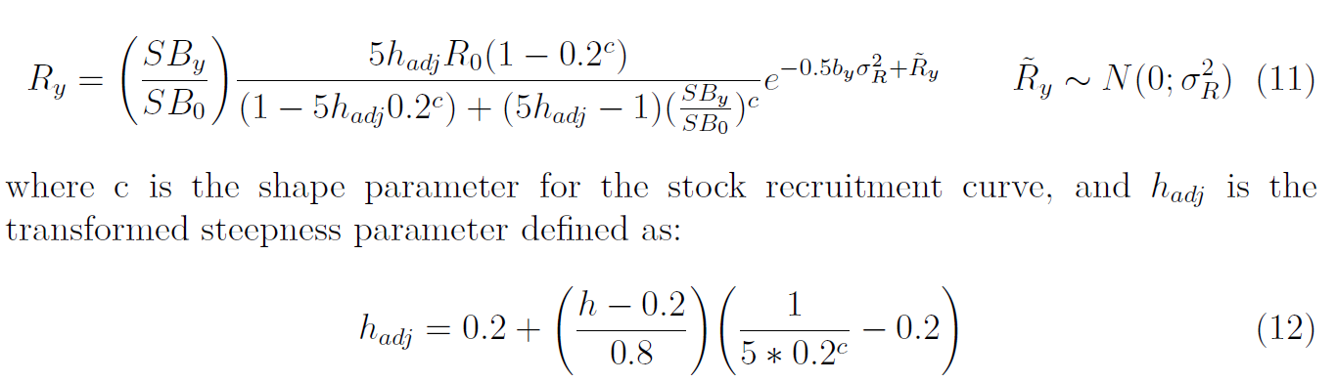
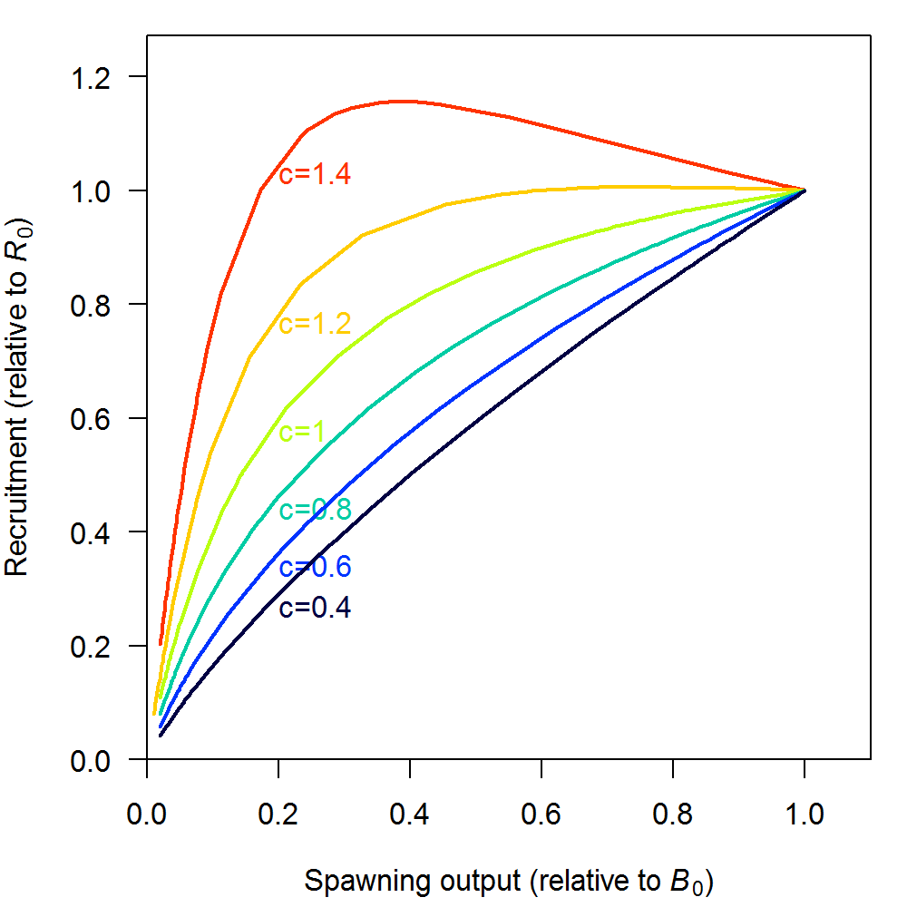
Shepherd
Shapes over range of c values with h = 0.6
Third parameter allows flexibility in relationship between B_{MSY}/B₀ and productivity
Not yet commonly used
How to find values for both h and c?
Shepherd, G. 1982. A versatile new stock-recruitment relationship for fisheries, and the construction of sustainable yield curves. ICES J. Mar. Sci. 40: 67-75.

Slide 13
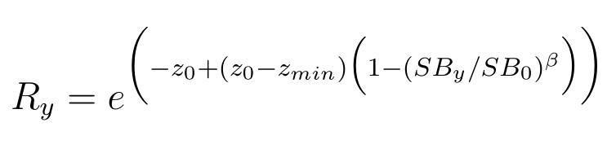
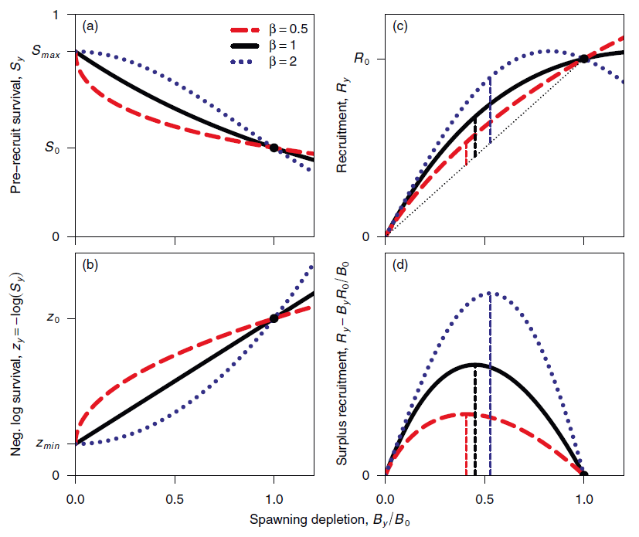
Low Fecundity Stock Recruit Relationship (a.k.a. Maunder-Taylor-Methot, or Survival-based recruitment)
Has been applied to low-fecundity species, but shape of survival curve may be useful elsewhere (see Maunder and Piner’s “Quest for the holy grail”)
How to get parameter values?
Taylor et al. (2013) A stock-recruitment relationship based on pre-recruit survival, illustrated with application to spiny dogfish shark. Fisheries Research 142: 15– 21.

Slide 14
Recruitment deviations
Overview
SigmaR
Bias adjustment
Eras (Init/Early, Main, Late/Forecast)
Statisticians say that all this would be simpler if recruitment deviations were modeled as a true random effects

Slide 15
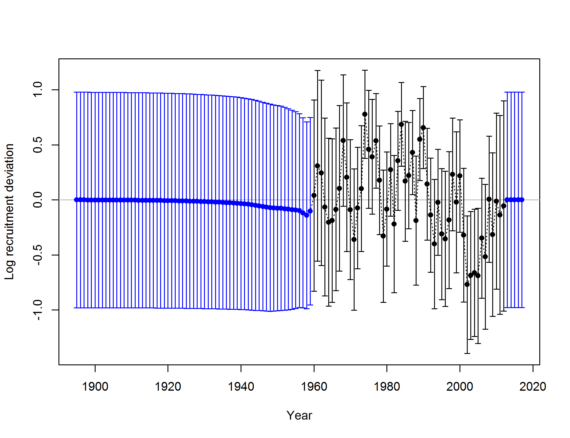
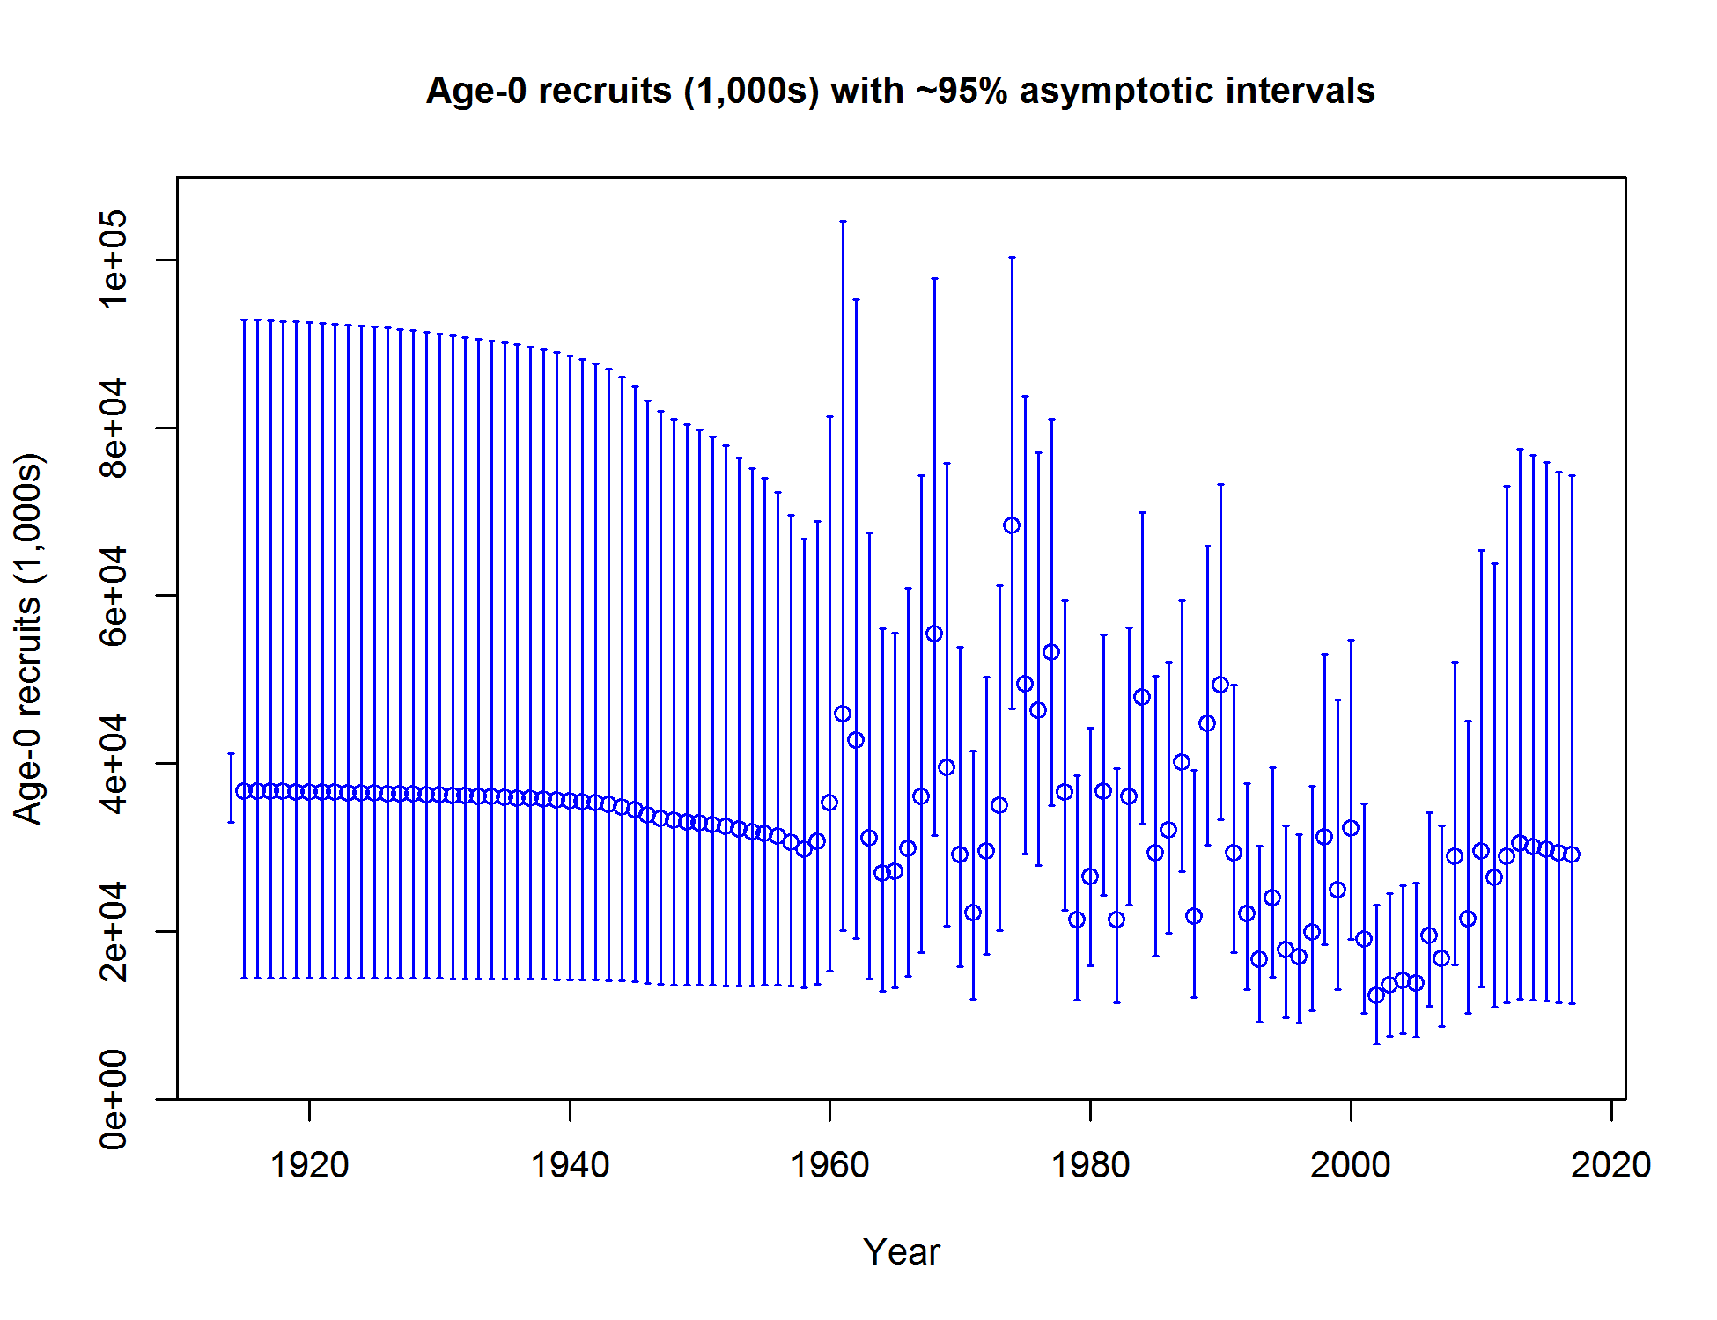
Recruitment in Rockfish Example
Recruitment estimates Recruitment deviations

Slide 16
Control file setup for recruit deviations
1 #do_recdev: 0=none; 1=devvector; 2=simple deviations
1960 # first year of main recr_devs; early devs can preceed this era
2012 # last year of main recr_devs; forecast devs start in following year
2 #_recdev phase
1 # (0/1) to read 13 advanced options
1895 #_recdev_early_start (0=none; neg value makes relative to recdev_start)
5 #_recdev_early_phase
5 #_forecast_recruitment phase (incl. late recr) (0 value resets to maxphase+1)
1 #_lambda for Fcast_recr_like occurring before endyr+1
1948.8 #_last_early_yr_nobias_adj_in_MPD
1974.9 #_first_yr_fullbias_adj_in_MPD
2006.5 #_last_yr_fullbias_adj_in_MPD
2012.5 #_first_recent_yr_nobias_adj_in_MPD
0.7034 #_max_bias_adj_in_MPD (-1 to override ramp and set biasadj=1.0 for all estimated recdevs)
0 #_period of cycles in recruitment (N parms read below)
-6 #min rec_dev
6 #max rec_dev
0 #_read_recdevs
#_end of advanced SR options

Slide 17
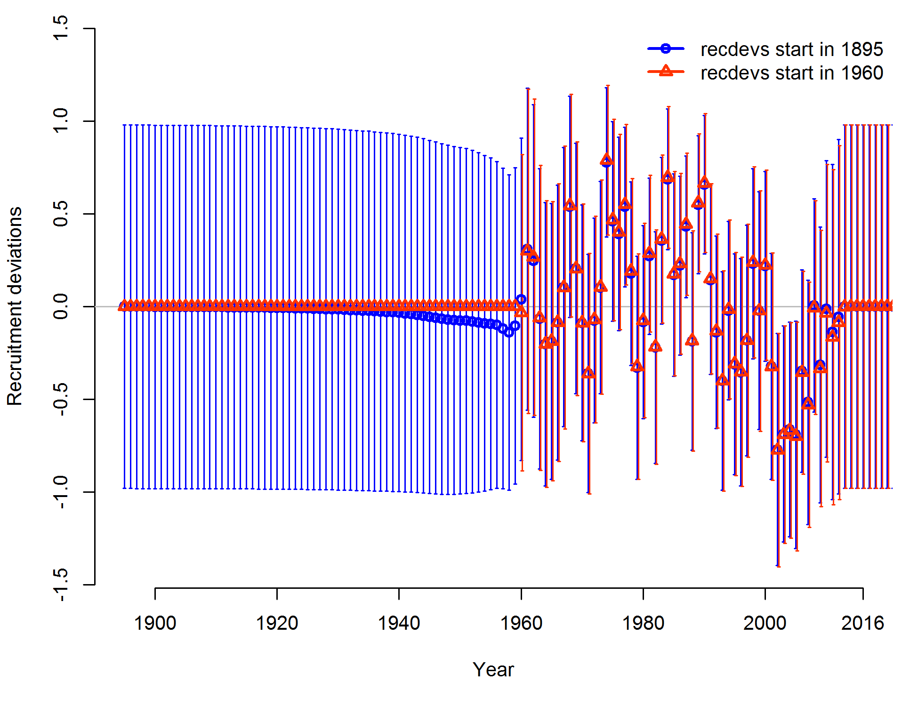
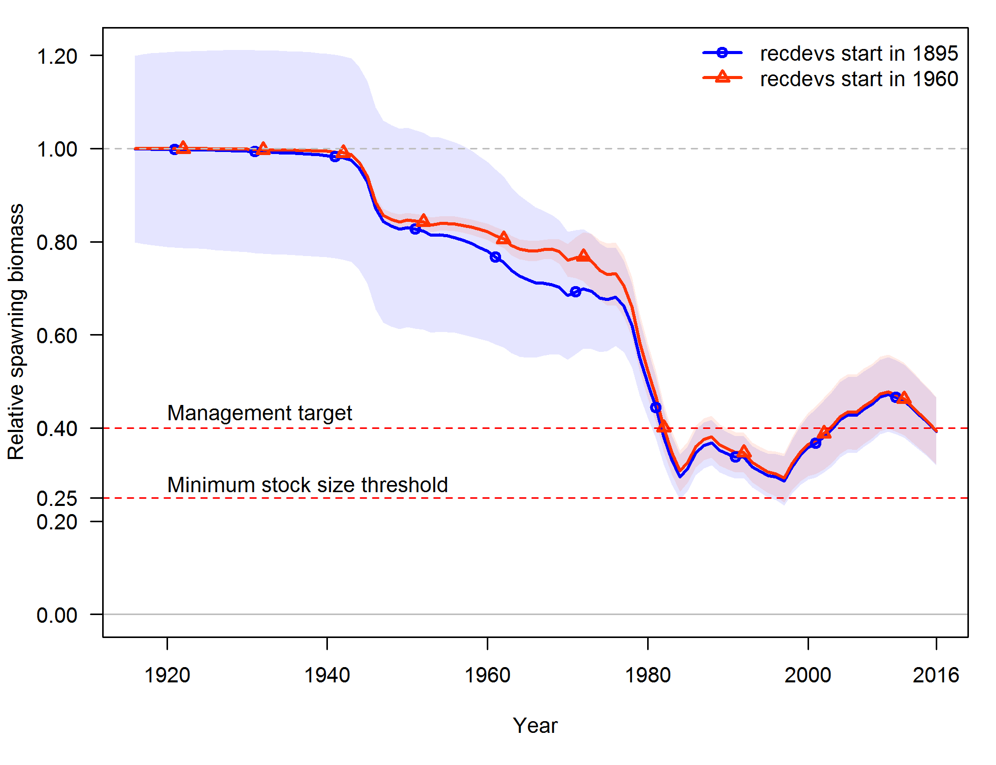
Impact of including early recruitment deviations

Slide 18
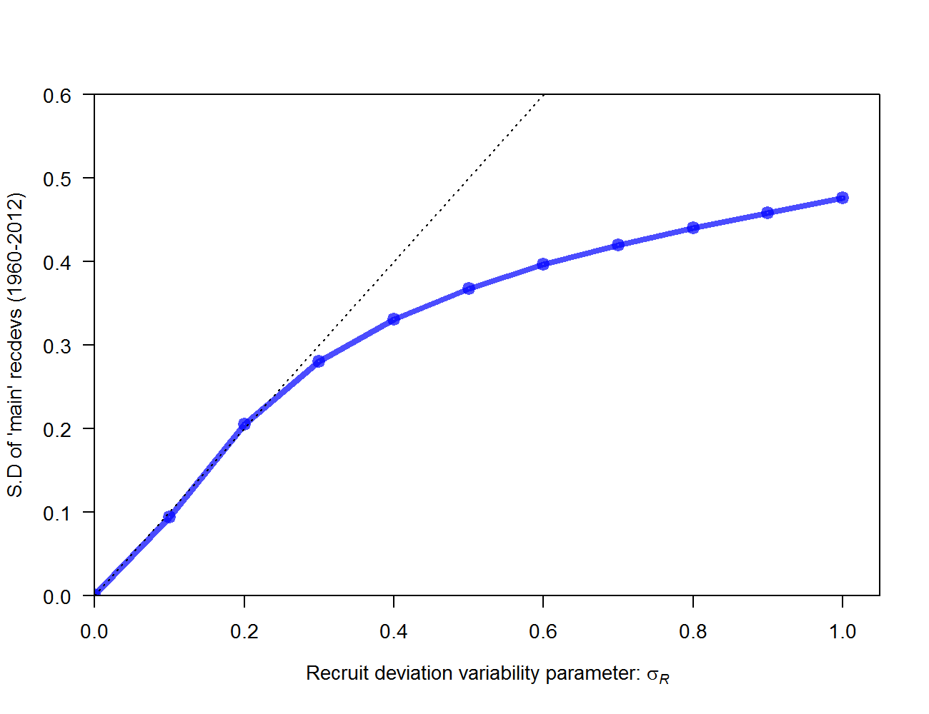
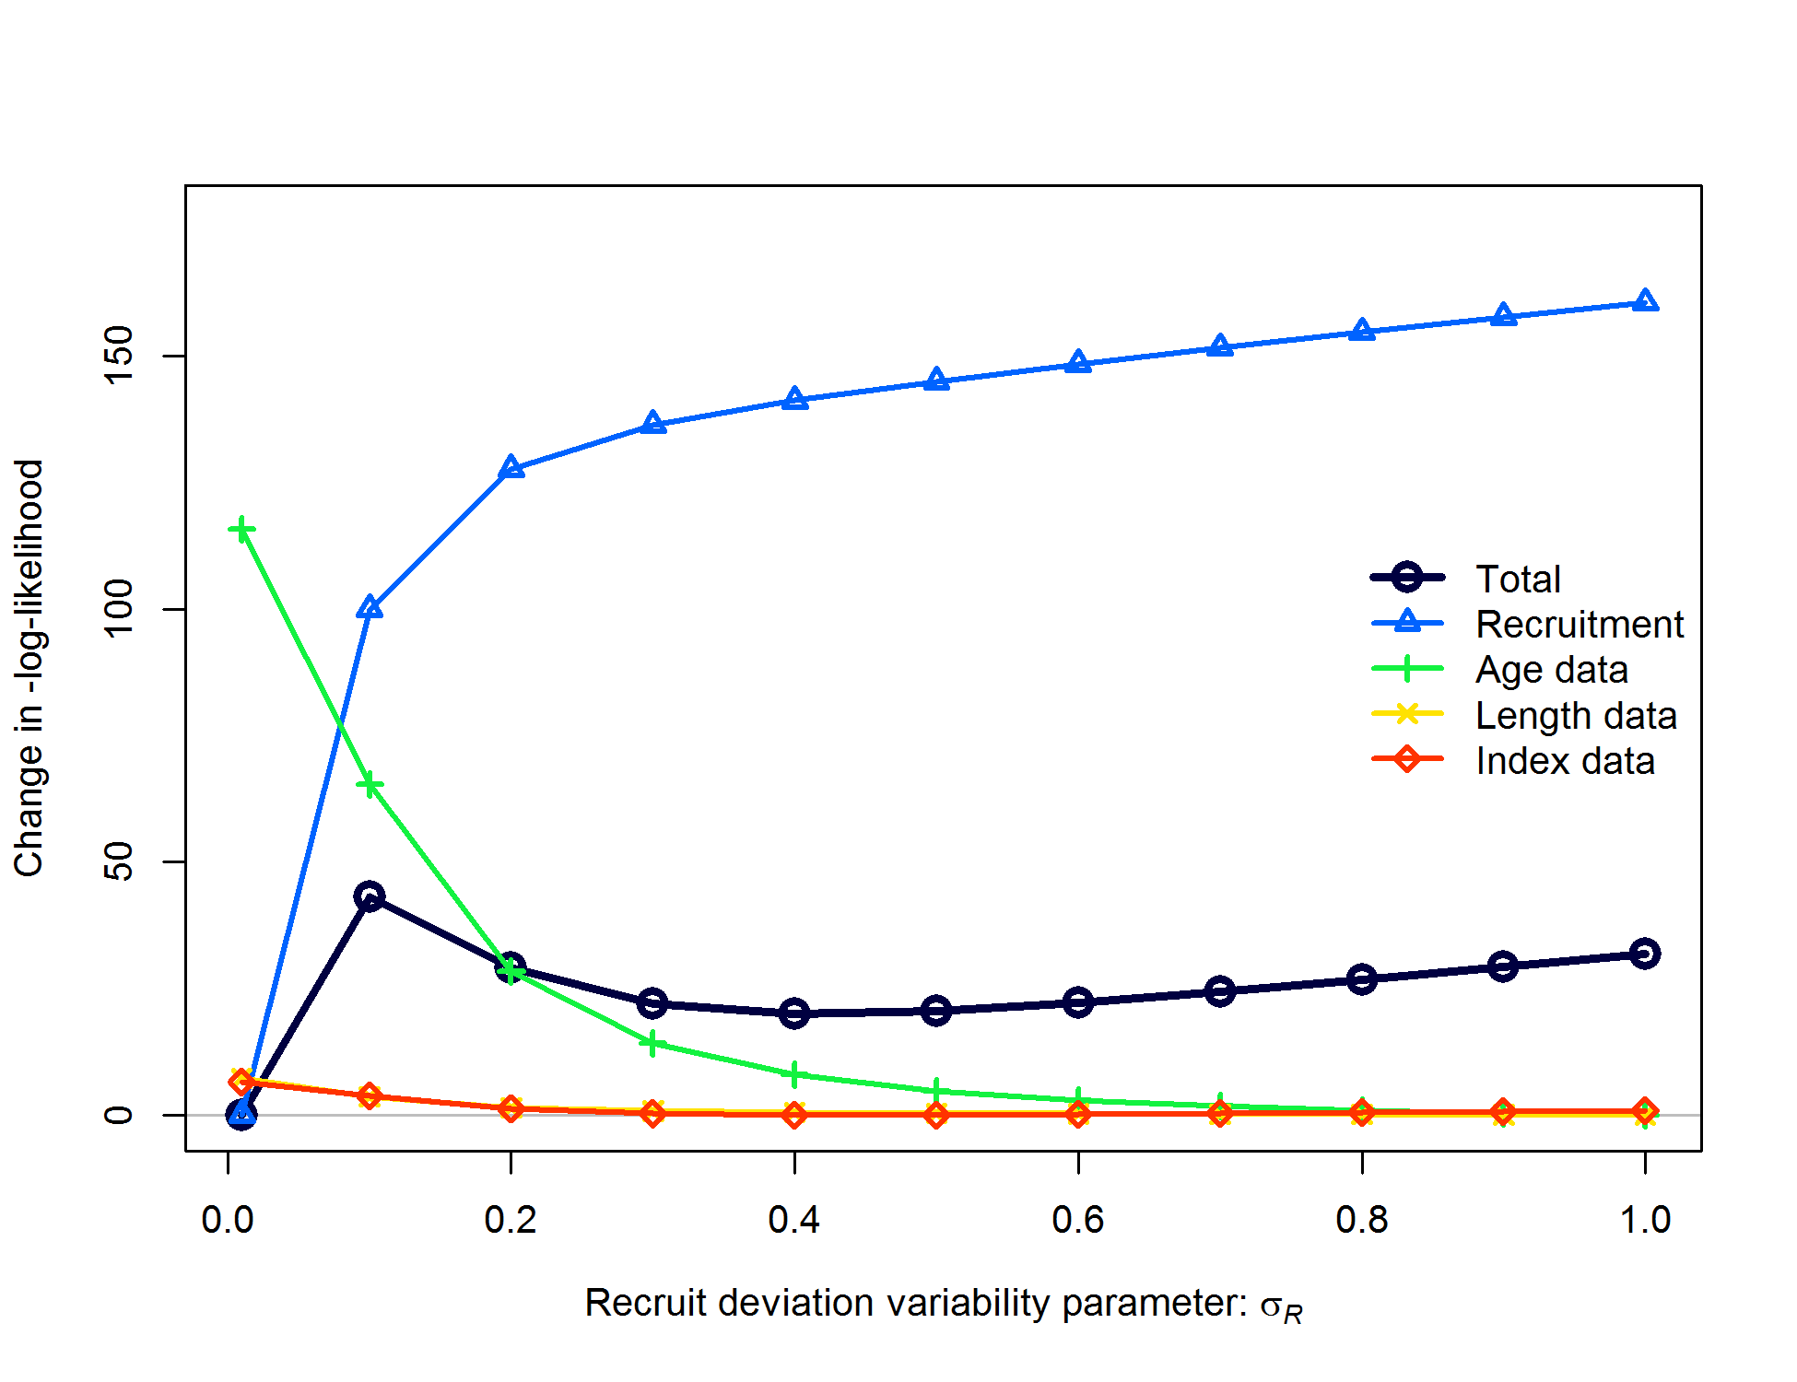
Recruit deviation variability parameter: σ_{R}
Estimated variability highly dependent on σ_{R}
Global minimum (in some cases) at σ_{R} = 0 not useful
Statisticians say that MLE of random effects variance is biased

Slide 19
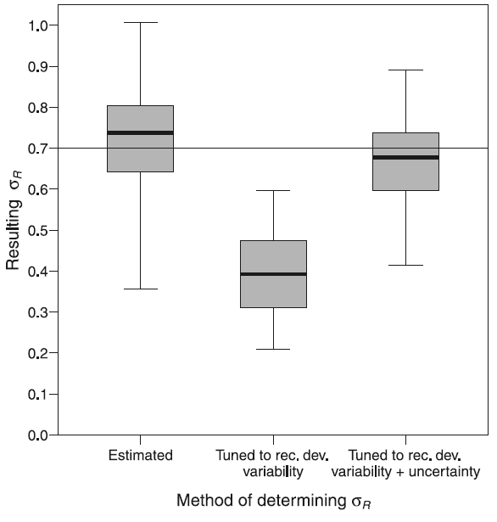

Recruit deviation variability parameter: σ_{R}
Accounting for uncertainty around recdev estimates improved estimation of σ_{R}:
r4ss function SS_output now includes additional table: $sigma_R_info
Thorson says square first, then take mean
> ex1$sigma_R_in
[1] 0.5
> ex1$sigma_R_info
period N_devs SD_of_devs Var_of_devs mean_SE mean_SEsquared
1 Main 53 0.3682 0.13558 0.3076 0.0998
2 Early+Main 118 0.2473 0.06113 0.4079 0.1770
3 Early+Main+Late 122 0.2432 0.05912 0.4109 0.1794
sqrt_sum_of_components SD_of_devs_over_sigma_R sqrt_sum_over_sigma_R
1 0.4852 0.7364 0.9703
2 0.4880 0.4945 0.9760
3 0.4884 0.4863 0.9768
alternative_sigma_R
1 0.4852
2 0.4880
3 0.4884
Methot, R.D. and Taylor, I.G., 2011. Adjusting for Bias due to Variability of Estimated Recruitments in Fishery Assessment Models. Can. J. Fish. Aquat. Sci. 68, 1744–1760.

Slide 20
Bias adjustment of recdevs
Difference between median and mean of lognormal distribution requires adjustment
However, periods with little information on recruitment will have no variability among deviations and thus not need the bias adjustment

Slide 21
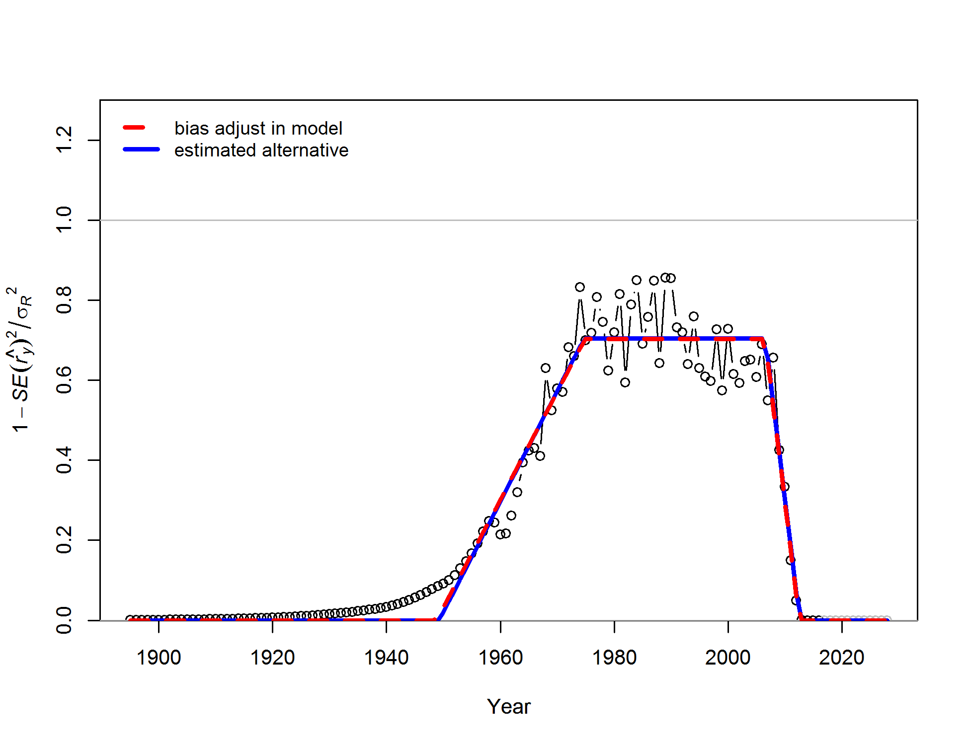
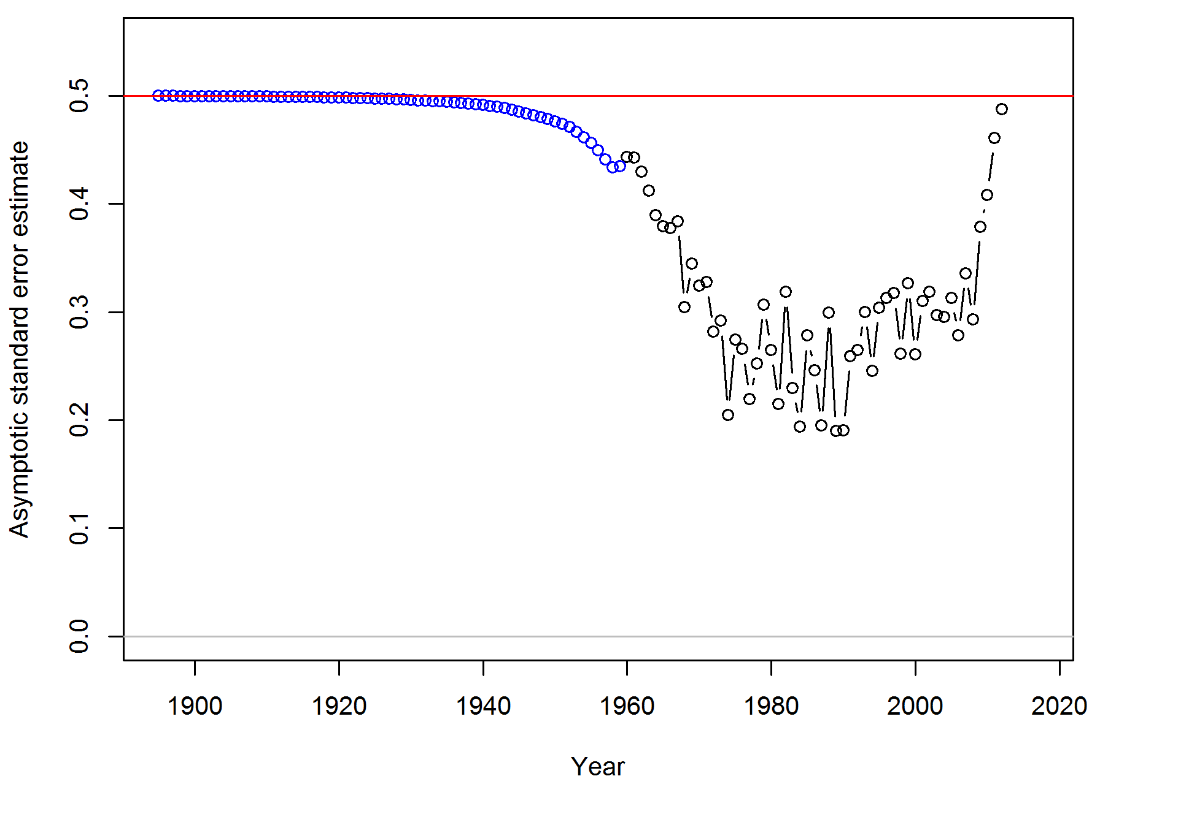
Recruitment estimates Recruitment deviations
Recdev uncertainty Transformed uncertainty

Slide 22
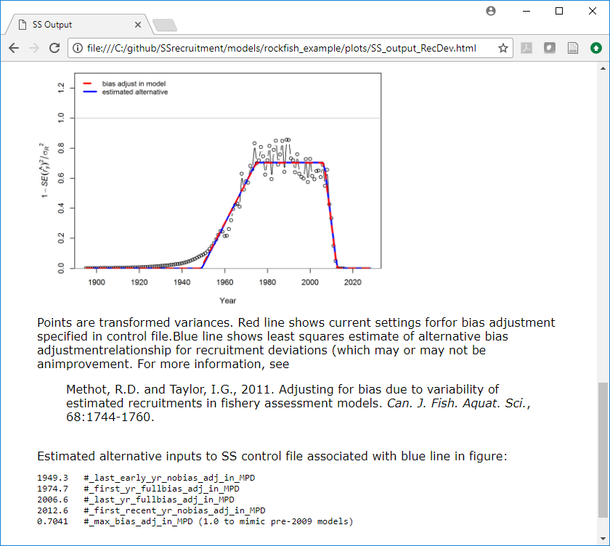
Bias adjustment
r4ss function SS_plots calls SS_fitbiasramp which estimates values for input to control file

Slide 23
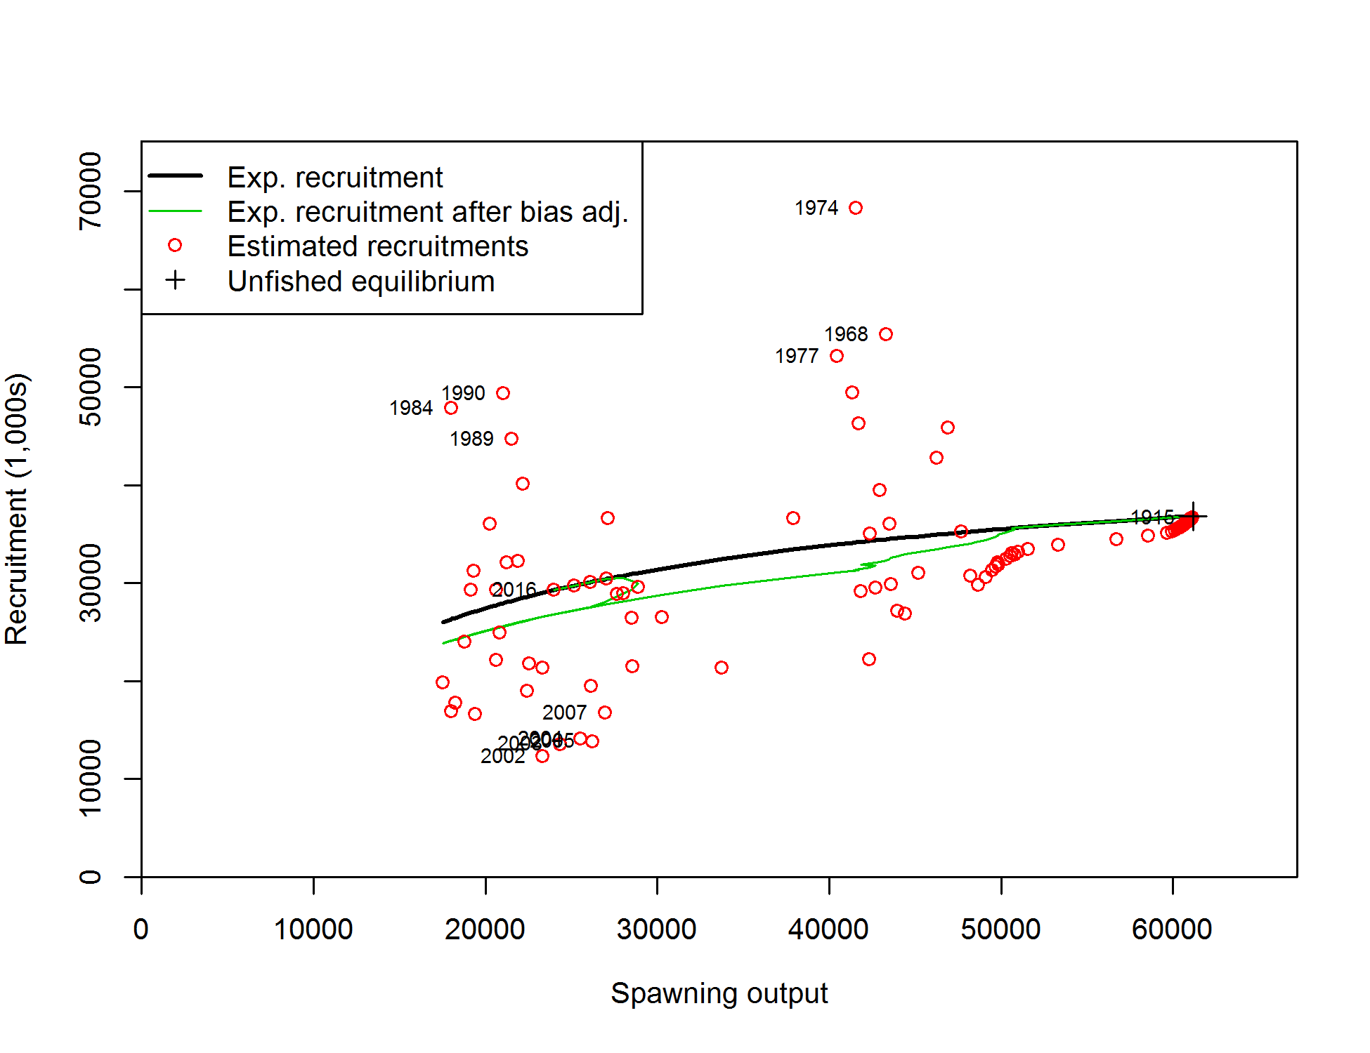
Impact of bias adjustment on stock-recruit curve

Slide 24
Eras (Init/Early, Main, Late/Forecast)
Intent of option is to prevent recdevs in periods with little information from being used to compensate for above- or below-average recruitment in data-rich period
Common practice is to use ‘main’ era only for period with information on recruitment
Easy to test impact of alternative assumptions
Recdevs prior to start year are used to adjust the initial age structure

Slide 25
Apportionment of recruitment
(to multiple areas, growth patterns, or settlement events)

Slide 26
Control file setup for recruit distribution
2 # recr_dist_method for parameters:
# 2=main effects for GP, Settle timing, Area;
# 3=each Settle entity;
# 4=none when N_GP*Nsettle*pop==1
1 # not yet implemented; Future usage: Spawner-Recruitment: 1=global; 2=by area
3 # number of recruitment settlement assignments
0 # unused option
#GPattern month area age (for each settlement assignment)
1 1 1 0
1 1 2 0
1 1 3 0

Slide 27
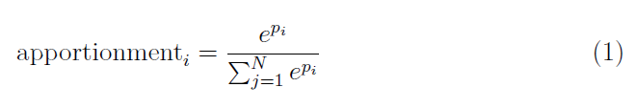
Distribution of recruitment
When multiple Growth Patterns, Areas, or Seasons are specified at the top of the data file, the model will expect additional parameters
Fix first parameter at 0
Estimate (or fix) additional parameters within a range like -5 to 5
Recruitment distribution can be (probably should be) time-varying
Need to think about interaction between variability of recruitment distribution and σ_{R}
No clear guidance on bias adjustment of recdevs in this context

Slide 28
Control file parameters for recruit distribution
#_growth_parms
#_LO HI INIT PRIOR PR_SD PR_type PHASE env_var devlink devminy devmaxy dev_PH Block Block_Fxn
0.04 0.08 0.0521 -2.9551 0.5323 3 -50 0 0 0 0 0.5 0 0 # NatM_p_1_Fem_GP_1
0 0.9 0.45 0.4 50 0 3 0 0 0 0 0.5 0 0 # NatM_p_2_Fem_GP_1
2 15 3.8 4 50 0 2 0 0 0 0 0.5 0 0 # L_at_Amin_Fem_GP_1
...
0 999 1 1 50 6 -50 0 0 0 0 0.5 0 0 # RecrDist_GP_1
-7 7 0 1 50 0 -1 0 0 0 0 0 0 0 # RecrDist_Area_1
-7 7 0 1 50 0 1 0 1 1933 2014 -5 0 0 # RecrDist_Area_2
-7 7 0 1 50 0 1 0 1 1933 2014 -5 0 0 # RecrDist_Area_3
0 999 1 1 50 6 -50 0 0 0 0 0.5 0 0 # RecrDist_timing_1
1 1 1 1 1 0 -1 0 0 0 0 0 0 0 # CohortGrowDev
0.00001 0.99999 0.5 0.5 0.5 0 -99 0 0 0 0 0 0 0 # FracFemale_GP_1
# timevary MG parameters
#_LO HI INIT PRIOR PR_SD PR_type PHASE
0.0001 2 0.5 0.5 0.5 6 -5 # RecrDist_Area_2_dev_se
-0.99 0.99 0 0 0.5 6 -6 # RecrDist_Area_2_dev_autocorr
0.0001 2 0.5 0.5 0.5 6 -5 # RecrDist_Area_3_dev_se
-0.99 0.99 0 0 0.5 6 -6 # RecrDist_Area_3_dev_autocorr
# info on dev vectors created for MGparms are reported with other devs after tag parameter section

Slide 29
Time-varying stock-recruit relationships (regimes)
Initial year vs. equilibrium (R₁ in 3.24) Environmental links Forecasting with high or low recruitments

Slide 30
Control file setup for stock-recruit function
#_Spawner-Recruitment
3 #_SR_function: 2=Ricker; 3=std_B-H; 4=SCAA; 5=Hockey;
# 6=B-H_flattop; 7=survival_3Parm; 8=Shepard_3Parm
0 # 0/1 to use steepness in initial equ recruitment calculation
0 # future feature: 0/1 to make realized sigmaR a function of SR curvature
#_LO HI INIT PRIOR PR_SD PR_type PHASE ... # parm_name
5 20 10.6 10 5 0 1 ... # SR_LN(R0)
0.2 1 0.6 0.718 0.158 0 3 ... # SR_BH_steep
0.5 1.2 0.5 0.67 99 0 -6 ... # SR_sigmaR
-5 5 0 0 99 0 -50 ... # SR_regime
0 2 0 1 99 0 -50 ... # SR_autocorr

Slide 31
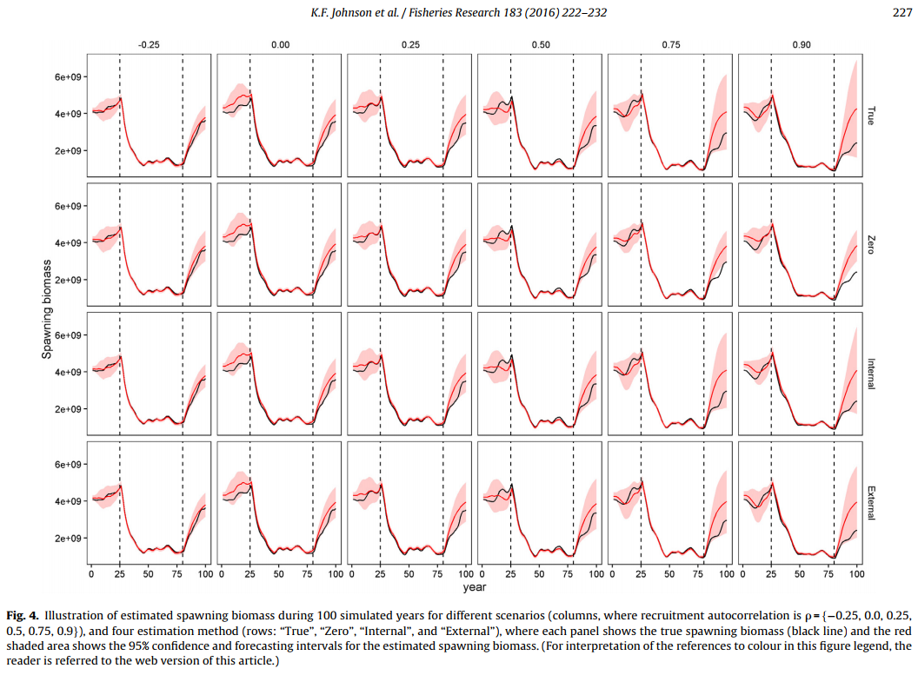
Recruitment autocorrelation
Johnson, K.F., Councill, E., Thorson, J.T., Brooks, E., Methot, R.D., Punt, A.E., 2016. Can autocorrelated recruitment be estimated using integrated assessment models and how does it affect population forecasts? Fish. Res. 183, 222–232.

Slide 32
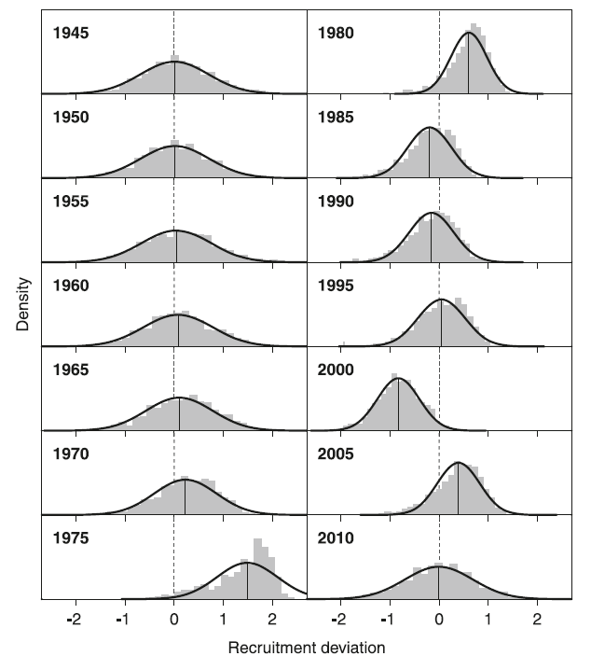
Recruitment in MCMC vs. MLE estimates
Bayesian estimation using MCMC simplifies some elements of recruitment estimation
No bias adjustment necessary: SS automatically overrides settings
Distributions are typically skewed: more information about big recruitments than small ones
Methot, R.D. and Taylor, I.G., 2011. Adjusting for Bias due to Variability of Estimated Recruitments in Fishery Assessment Models. Can. J. Fish. Aquat. Sci. 68, 1744–1760.
Stewart, I.J., A. Hicks, I.G. Taylor, J.T. Thorson, C. Wetzel, and S. Kupschus. 2013. A comparison of stock assessment uncertainty estimates using maximum likelihood and Bayesian methods implemented with the same model framework. Fish. Res. 142, pp 37–46.

Slide 33
Simulating with random recruitment
SS has built-in parametric bootstrap capability for random data generation, but most analyses benefit from random recruitment
Option 1: modify the ss.par file
Option 2: input in control file
122 #_read_recdevs
#_end of advanced SR options
# read specified recr devs
#_Yr Input_value
1895 -0.06873
1896 -0.97538
1897 0.11130
...
Control file input can be facilitated by r4ss function: > SS_recdevs(fyr=1895, lyr=2016, dir=mydir)
[1] making recdev phase to negative: -2
[1] rescaling recdevs vector so yrs 1895:2016
[1] have mean 0 and std. dev. = sigmaR = 0.5
[1] wrote new file: control_modified.ss

Slide 34
A few ideas for the future:
Density-dependent recruitment variability
Area-specific spawning biomass
Semi-parametric stock-recruit curve

Slide 35
References
Methot, R.D. and Taylor, I.G., 2011. Adjusting for Bias due to Variability of Estimated Recruitments in Fishery Assessment Models. Can. J. Fish. Aquat. Sci. 68, 1744–1760.
Shepherd, G. 1982. A versatile new stock-recruitment relationship for fisheries, and the construction of sustainable yield curves. ICES J. Mar. Sci. 40: 67-75.
Stewart, I.J., A. Hicks, I.G. Taylor, J.T. Thorson, C. Wetzel, and S. Kupschus. 2013. A comparison of stock assessment uncertainty estimates using maximum likelihood and Bayesian methods implemented with the same model framework. Fish. Res. 142, pp 37–46.
Taylor, I.G., V. Gertseva, R.D. Methot, and M.N. Maunder. 2013. A stock-recruitment relationship based on pre-recruit survival, illustrated with application to spiny dogfish shark. Fish. Res. 142, pp 15–21.

